Slide 1


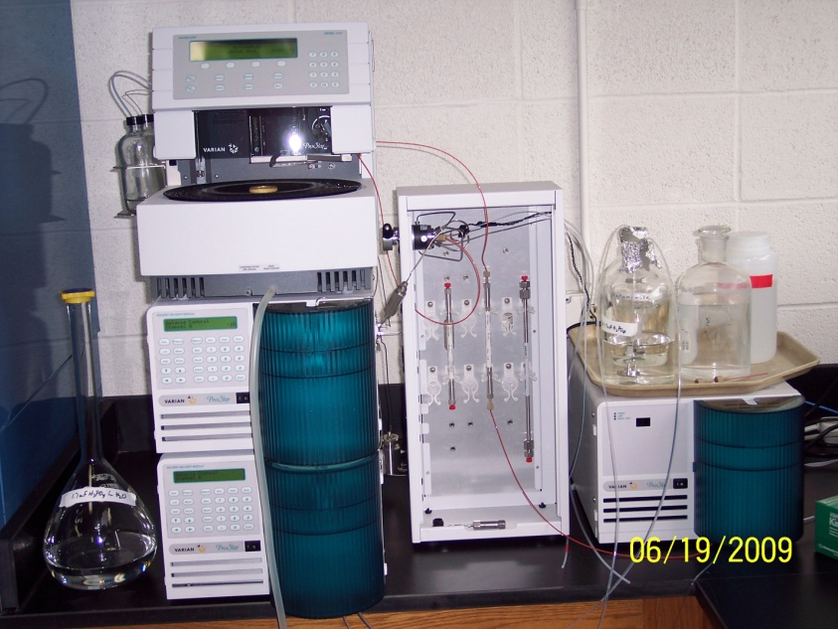
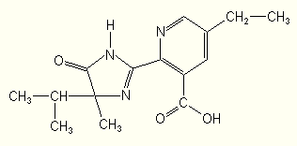
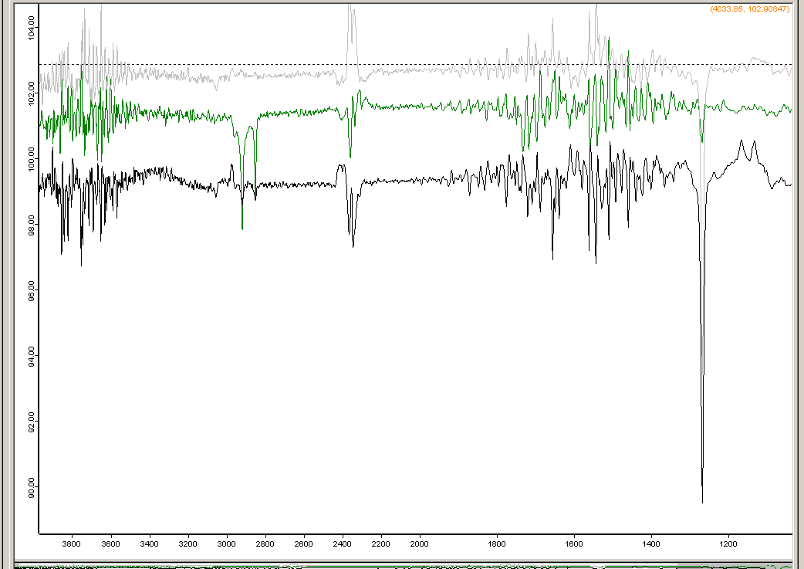
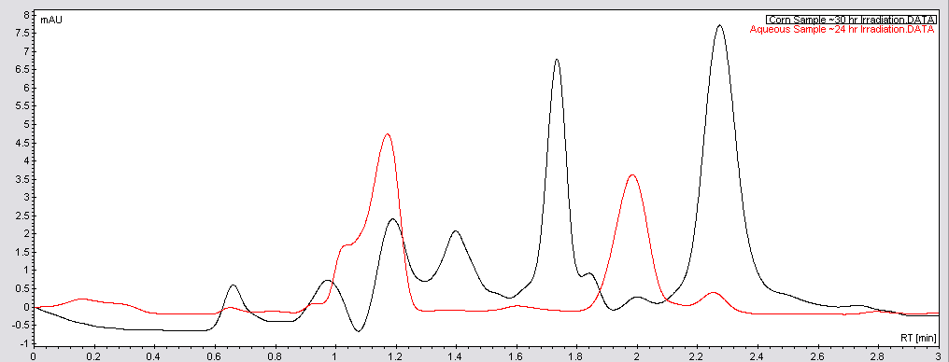
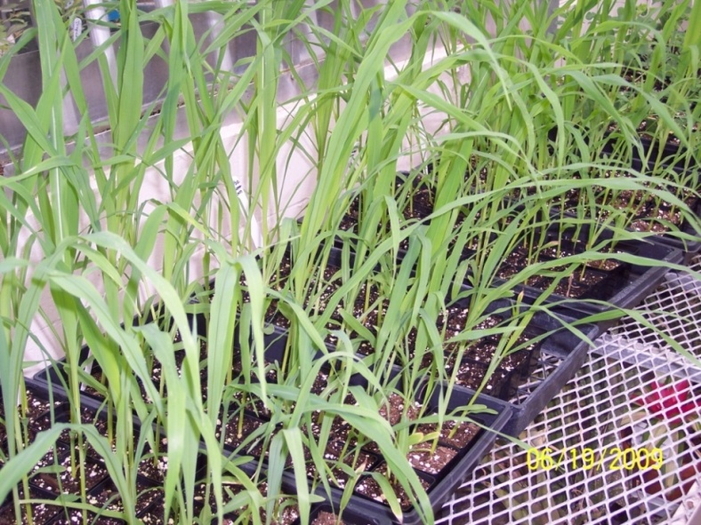
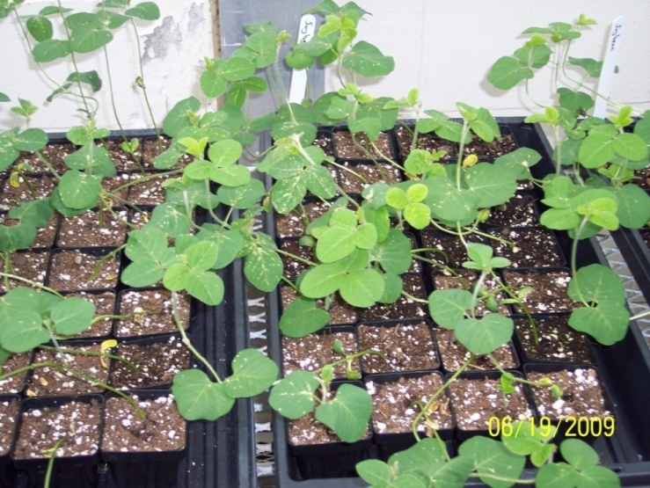
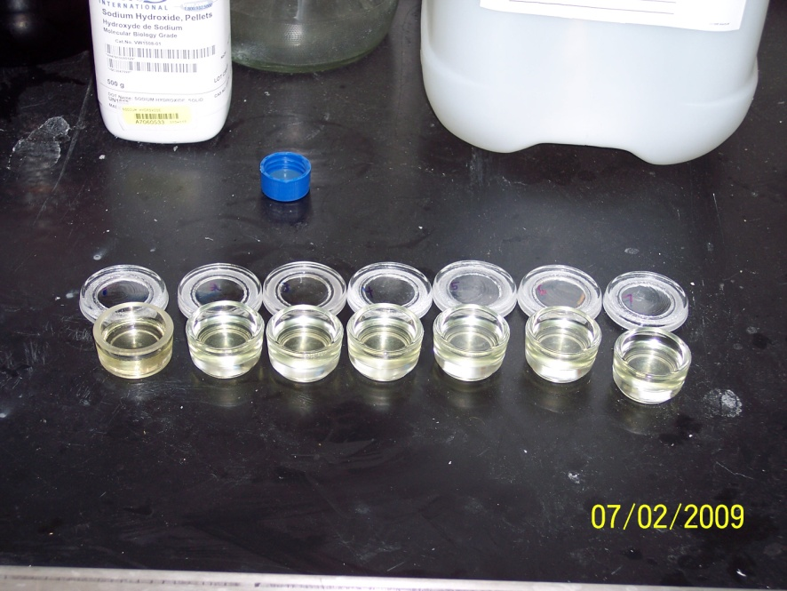
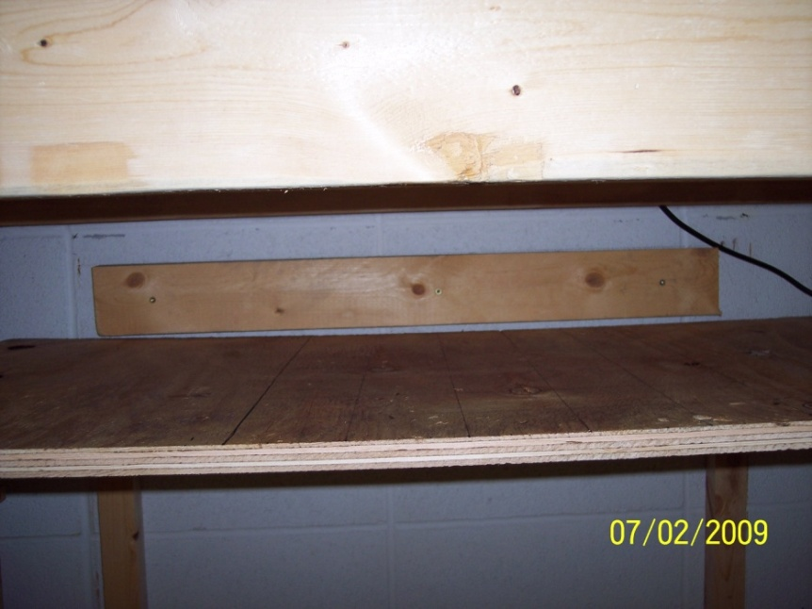
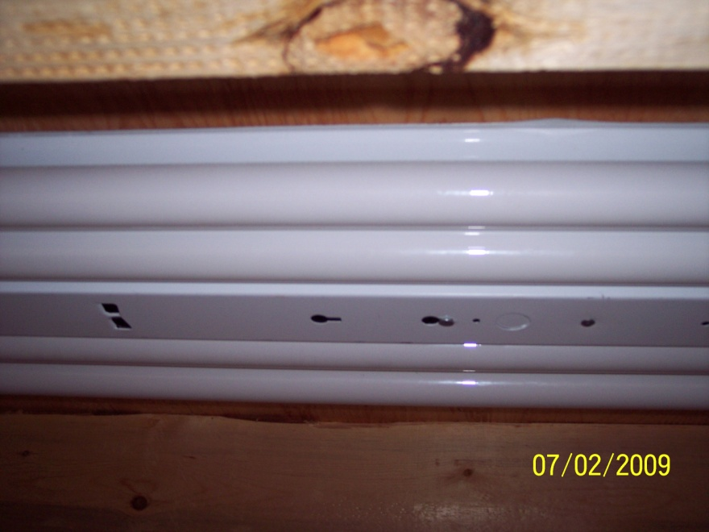
Photolysis of Imazethapyr on the Cuticle Wax of Corn (Hyb jubilee) and Soybeans (Soya hispida)
Spencer Bonnerup, Megan Olson, Dr. Amanda Nienow
Department of Chemistry, Gustavus Adolphus College, St. Peter, MN 56082
Sponsor: Howard Hughes Medical Institute
Introduction
After application to crops, pesticides can undergo a variety of physical or chemical processes/reactions. The three major processes/reactions include penetration into the epicuticular wax, volatilization into the atmosphere, and/or photochemical transformation.
Imazethapyr is an imidazolinone herbicide used to control weeds in agricultural fields.¹ Due to weak absorption to soil and stability to hydrolysis, photolysis is a major degradation pathway of imazethapyr that has run-off into natural water systems. To date, the photolysis of imazethapyr has only been studied in aqueous solutions.^{2,3} This poster examines the photolysis of imazethapyr on the cuticle waxes of corn and soybeans, two local crops on which imazethapyr is applied. The objectives of the study are to determine if photolysis is a major degradation pathway of imazethaypr on these waxes, how photolytic degradation on the waxes differs from degradation in aquatic systems, and to characterize the waxes studied.
Analytical Methods
All samples were analyzed with a Varian LC Prostar with a 410 autosampler, 210 delivery system, and 325 UV-Vis detector. The column used was a Discovery RP Amide C16 reversed-phase column with 150 mm x 4.6 mm ID and 5 mm particle size. The solvent mixture was 55/45 (v/v) 1.7 mF Phosphoric Acid (~pH 3)/Acetonitrile with a flow rate of 2.0mL/min. Detection was set at λ=220 nm.
Comparing to Control and Aqueous Samples
Sample | k (hr ⁻¹) | t_{½} (hr)
Corn Wax 1, Irradiation 1 | 0.0450 | 15.4
Soybean Wax 1, Irradiation 1 | 0.0254 | 27.29
Glass Control 1 | 0.0560 | 12.38
Glass Control 2 | 0.0627 | 11.05
Aqueous Sample, 15 ppm | 0.2040 | 3.40
Varian LC Prostar HPLC
Imazethapyr
Characterization of Waxes
A Bruker Tensor 27 FT-IR and a Cary 100 UV-Vis spectrometer were used to obtain the following spectra of corn and soybean waxes dissolved in dichloromethane.
The degradation half-life of imazethapyr plated on glass (no wax) was 11.7 ± 0.9 hr, faster than the degradation half-lives of imazethapyr plated on both corn and soybeans. Therefore, the wax appears to play a role in the degradation causing the rate to be slowed dramatically. This may be due to light absorption by the wax effectively removing some light from interacting with imazethapyr.
As illustrated by the graph, imazethapyr dissolved in pH 7 phosphate buffer degrades much more quickly than imazethpyr on the plates or waxes.
Grey: Solvent
Green: Soybean
Black: Corn
FT-IR spectra show that corn wax contains C=O, C=C, and C-H functional groups and that soybean wax contains C=O, C=C, C-H, O-H.
UV-Vis spectra show that soybean wax absorbs much more strongly than corn and at slightly different wavelengths.
Experimental Methods
Corn
Degradation of Imazethapyr on Corn Wax
A series of experiments with corn was conducted in order to address the following questions:
Does irradiating the waxes repeatedly lead to changes in the photodegradation of imazethaypr?
Do the conditions under which the corn is grown lead to changes in the wax composition sufficient to alter the photodegradation of imazethapyr?
Soybeans
Corn and soybeans were grown in the Alfred Nobel Hall of Science Greenhouse. At the three or four leaf stage, the stage of imazethapyr application in the fields, the leaves of the plants were cut. Cut leaves were submerged in dichloromethane for two minutes to extract the cuticle waxes.⁴ Some of the resulting solution was kept for characterization of the waxes. The remainder of the solution was filtered, concentrated and plated onto 35 mm glass plates.
Chromatograms of irradiated corn/imazethapyr samples (black) show different degradation products than chromatograms of irradiated aqueous imazethapyr samples (red), suggesting that the mechanism of degradation may be different. Remaining imazethaypr is the peak at ~2.26 min in each chromatogram.
Sample | k (hr ⁻¹) | t_{½} (hr)
Irradiation 1, Wax 1 | 0.0450 | 15.4
Irradiation 2, Wax 1 | 0.0481 | 14.4
Irradiation 3, Wax 1 | 0.0819 | 8.46
Irradiation 1, Wax 2 | 0.0156 | 44.43
k=0.0450 hr⁻¹
r²=0.954
σ_{m}= 0.0297
Future Studies
Some of the experiments presented need to be repeated or conducted in more depth. This includes repeating experiments with aqueous samples of imazethaypr and conducting more experiments with soybean wax.
We would like to make this experiment more like field conditions. To do this, we hope to conduct an experiment in which we spray the leaves of corn and soybeans directly with imazethapyr solution and irradiate the plants directly under the solar simulator.
Wax on glass plates
Once the dichloromethane had evaporated, the glass plates were heated to form a uniform wax layer in the bottom of the dish. Aqueous solutions of imazethapyr (3.88 ppm) was then added to the glass plates and the water was evaporated overnight. The plates were finally irradiated in the solar simulator (with four Q-Lab UVA-340 lamps) for up to 30 hours. At preset time points, a glass plate was removed from the solar simulator and the remaining imazethapyr was extracted from the surface using deionized water and was saved for analysis. Several controls experiments were also conducted, including plating and irradiating imazethapyr on the plates without wax.
The half-lives of imazethapyr degradation decrease upon successive irradiation of the same waxes, suggesting that the wax may be changing upon irradiation.
The half-life of imazethapyr degradation on Wax 2 is much different than the half-lives on Wax 1 giving preliminary results that growing conditions may be an important factor.
Degradation of Imazethapyr on Soybean Wax
Acknowledgements and References
Acknowledgements: Ryan Espy, Howard Hughes Medical Institute, Gustavus Adolphus College
References:
1. Occurrence of sulfonylurea, sulfonamide, imidazolinone, and other herbicides in rivers, reservoirs and ground water in the Midwestern United States, 1998 W.A. Battaglin, et al. Sci. Tot. Environ., 2000, 248(2-3), 123-133.
2. Imazethapyr Aqueous Photolysis, Reaction Quantum Yield, and Hydroxyl Radical Rate Constant L.A. Avila, et al. J. Agri. Food Chem., 2006, 54(7), 2635-2639.
3. Photolytic & Hydrolytic Degradation of Imazethapyr, Ryan D. Espy, Amanda Staker, Dr. Amanda M. Nienow. Poster at American Chemical Society Meeting, March 2009.
4. Phototransformation of the Herbicide Sulcotrione on Maize Cuticular Wax A ter Halle, et al. Env. Sci. Technol., 2006, 40, 2989-2995.
Sample | k (hr ⁻¹) | t_{½} (hr)
Irradiation 1, Wax 1 | 0.0254 | 27.29
Irradiation 2, Wax 1 | 0.0341 | 20.33
k= 0.0341 hr⁻¹
r²= 0.769
σ_{m} = 0.0127
Degradation of imazethapyr on soybean wax is slower than on corn wax. This may be due to the strong absorption of soybean wax at 340 nm.
The half-lives of degradation also decrease upon successive irradiation of the waxes.
Solar Simulator

